Slide 1
ALCHEMY AND ARTIFICIAL INTELLIGENCE
BY HUBERT DREYFUS
1965

Slide 2
DREYFUS’S GOALS
TO EVALUATE THEN EXISTING AI PROGRAMS (AS OF 1965) AND TO ASSESS THE TRUTHFULNESS OF CLAIMS MADE ON THEIR BEHALF BY RESEARCHERS
TO EXPLAIN THE DIFFICULTIES ENCOUNTERED BY SUCH ATTEMPTS TO EMULATE HUMAN INTELLIGENT ACTIVITIES USING DISCREET-STATE RULE-FOLLOWING MACHINES, I.E. TURING MACHINES
TO DETERMINE WHETHER SUCH MACHINES ARE IN PRINCIPLE CAPABLE UP TO THIS TASK

Slide 3
DRUYFUS’S REVELATIONS
DESIGNERS OF AI, AS WELL AS THE GENERAL PUBLIC, SEEM INCAPABLE OF GIVING A FAIR ASSESSMENT OF WHAT AI HAS ACHIEVED. AS IN SO MANY OTHER REPSECTS, PEOPLE VASTLY UNDERESTIMATE THE DIFFICULTY OF EMULATING THE SIMPLEST OF HUMAN INTELLIGENT ACTIVITIES. THIS IS COMPOUNDED BY THE TENDENCY TO OVERESTIMATE THE PROGRESS OF TECHNOLOGY IN GENERAL.
MORE IMPORTANTLY, THE UNDERLYING PREJUDICE OF THE DESIGNERS OF AI IS THAT HUMAN MINDS OPERATE IN THE SAME WAY AS TURING MACHINES.
THIS IS A VERY DEEP PREJUDICE THAT LEADS EXPERTS IN AI TO A CERTAIN BLINDNESS TO HUMAN MODES OF THOUGHT THAT ARE NOT OF THE RULE-FOLLOWING TYPE

Slide 4
DRUYFUS’S CLAIMS
”Now, before we invest more time and money on the information-processing level, we should ask whether the protocols of human subjects suggest that computer language is appropriate for analyzing human behavior. Is an exhaustive analysis of human behavior into discrete and determinate operations possible? Is an approximate analysis of human intelligent behavior in such digital terms probable? The answer to both these questions seems to be, “No.” p. 84.

Slide 5
Dreyfus’s Argument in Three Steps
Dreyfus argues for this claim in three steps:
Step 1: Show that human information processing is different in kind from computer information processing. This explains why it is so hard to replicate human processing, but does not prove it is impossible to do so.
Step 2: Show that the information processed is not the same in principle. This should show that it is impossible in principle.
Step 3: Show that (or at least strongly argue that) the reason for the differences in processing found in step one is the difference in the information processed in step 2.

Slide 6
Dreyfus’s Argument: Step 1
There exist at least three uniquely human forms of information processing, which designers of AI either simply ignore or assume is underpinned by unconscious but still determinate and discrete rule-following processes in the mind. These are:
Fringe consciousness
Essence/Accident Discrimination
Ambiguity Tolerance
A fourth, derivative form is perspicuous grouping.
The goal of this argument is to show that the Turing machine might not be able to fully emulate human intelligent behavior because human intelligent information-processing occurs in ways that are different from and irreducible to following a program, i.e. a finite and explicit set of rules expressed either in natural or computer language.

Slide 7
Dreyfus’s Unique Forms of Human Information Processing
Fringe Consciousness
Essence/Accident Discrimination
Ambiguity Tolerance
Perspicuous Grouping

Slide 8
Dreyfus’s Arguments: 2
The information contained in the world as we engage with it is non-programmable in three deep ways. However, all three ways amount to the same thing: the world is not a set of facts or rules.
Unlike the previous argument, this argument aims to show that, leaving aside the question of the nature of human thought, the representation that the mind has of the world cannot be replicated in the kind of representation fed into a digital computer.
In a very deep sense, the philosophical point underlying this argument is that the mind-world relationship is the hidden basis for making anything explicit in language and as such it cannot be made explicit itself. There can thus be no complete theoretical explanation of how the mind inhabits and relates to the world.

Slide 9
Dreyfus connects this second stage of the argument with the earlier one on page 65: “I propose to show that, near or far off, there does exist a boundary to possible progress in the field of artificial intelligence: given the nature of the information to be processed, the contribution of the uniquely human forms of information processing which we have considered are indispensable, since they alone provide access to information inaccessible to a mechanical system.”

Slide 10
Form One
Since all information fed into a digital computer must be fully explicit and discrete, and it takes humans to formulate such information from information that is not explicit and discrete, a computer can never – in this respect – rival the human being.
Another way to say this, is the human being alone has the authority to turn non-explicit information into explicit information fed into a computer. Whether this process ”counts” as successful is only determinable by a human being. Hence, computers cannot “rival” this aspect of human information processing.
A third way to put this is that a computer itself can never determine what counts as intelligent behavior.

Slide 11
Form Two
Given the problem of the exponential growth of possibilities, computers can only handle relatively restricted problems, and this only with the help of heuristics which greatly reduce the number of relevant factors. Chess is a good example.
Real-world problems contain an indefinite (i.e. practically infinite) number of factors that could be relevant to properly solving a problem. Computers as they now exist, would necessarily have to ignore certain factors which could turn out to be relevant. Human beings are not restricted in this way, due to fringe consciousness.
The key idea here is that a computer is inherently less universal than the human mind due to its need for explicitly setting aside complexity.

Slide 12
Form Three
Human intelligence seems to be able to alter the way in which it conceptualizes its problems. The context of a problem is always ambiguous and is open to multiple interpretations. This is because the what is explicit cannot fully determine its own meaning. This would entail a circularity, because the parts are given meaning through relation to other parts, which are defined. Eventually, those definitions cannot be further interpreted without presupposing a new context and so on. Human beings are not troubled by this, because they do no require explicit rules in order to make progress on solving a problem. We can totally recast the framework within which we understand a problem and are instead driven by a vague sense of what success and failure might mean. Human intelligence is not calculation intelligence, but conception forming.

Slide 13
A Hidden Argument Against NN?
P. 58-61.

Slide 14
A Short History of Machine vs. Human Competition (1 of 2)
1958 Alex Bernstein’s Chess Program played on IBM’ supercomputer, calculating 4-ply, seven moves at each ply, was a Shannon type A machine. First to implement the search-ahead idea.
NSS (Newell, Simon and Shaw) at Carnegie Mellon. First to beat a human, though someone just taught the moves. Was a Shannon type B machine.
1962 Alan Kotok, worked at MIT, followed the progress of NSS, also focused on type B. First to fully implement “alpha-beta” heuristic.
1966: 9-month match between Russian program by Alexander Konrod’s type A machine (assisted by Botvinnik) and Kotok’s type B machine, now headed by John McCarthy at Stanford. The Soviet machine won with two wins (at 5 ply) and two draws (at 3 ply).

Slide 15
Circa 1967: Richard Greenblatt, an undergraduate at MIT develops MacHack VI, with a USCF rating of 1239 (highest rating 1523). Follows the Kotov model. Many firsts: first to compete in a human tournament, first to get an official rating. Same year Simon predicted in 1957 that computers would be world champion.
In terms of technology:
Employed a “quiescence” search.
First to use an opening book (around 8-10000 moves)
Invented transposition tables (”hash tables”)

Slide 16
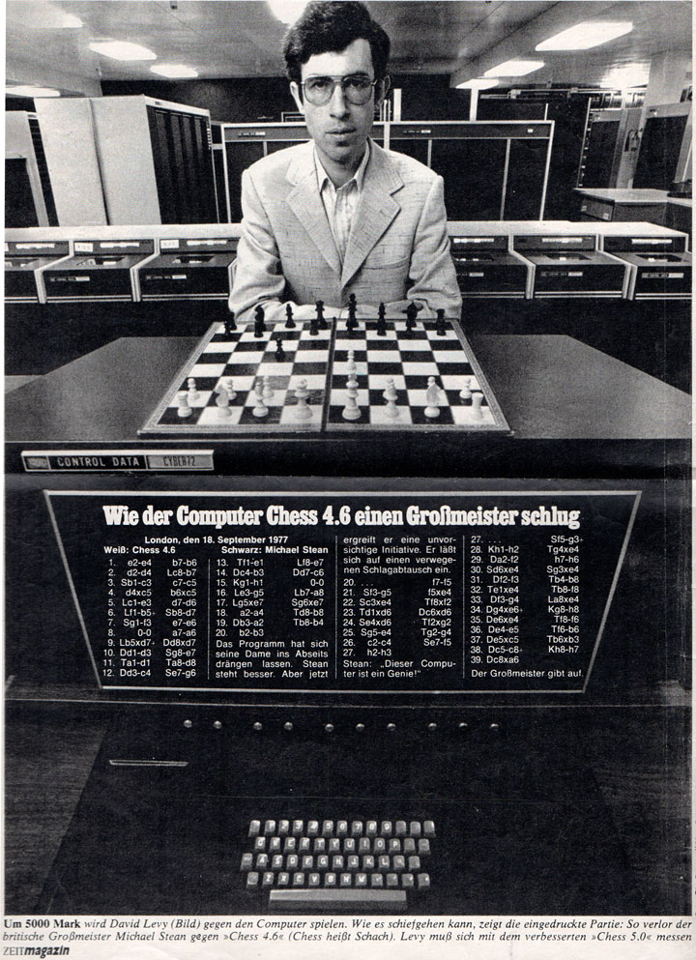
1968: David Levy, a chess master of over 2,300 Elo, makes a bet with John McCarthy: £500 that Levy will be beaten in a match against a computer. This became one of the driving “milestones” of AI for the next several decades.
1970: Birth of the Association for Computing Machinery (ACM) Chess tournament. MacHack did not participate.
Instead: New programs by Hans Berliner (J. BITT), a strong chess player and PhD. student at Carnegie Mellon.

Slide 17
Larry Atkin, Keith Gorlen and David Slate (Chess 3.0), undergrads at Northwestern, and others.
Both J. BITT and Chess 3.0 were Shannon Type B machines, and thus relied on a plausible move generator. Chess 3.0 surprisingly won 3-0.
1973: Atkin and Slate dump the Shannon B model, opting for a Shannon A machine that searched full-width. Innovated by using as much time as allowed, instead of searching to a determined depth.
1975: Chess 4.0 reaches an USCF rating of 1572.
On this model various versions of Chess x.w dominated computer tournaments until 1979, although MacHack did not participate.
1976: Chess 4.5 reaches a rating of 1822.
1977: Chess 4.6 reaches a rating of around 2200 (really maybe 2000) and beats a grandmaster, Michael Stean, in an exhibition match.

Slide 18
In the meantime … Russian programmers Arlazarov, Uskov and Donskoy continued to work with Botvinnik on a program called Kaissa (after the goddess of chess). It won the first World Computer Championship in 1974 4-0, beating Chess 4.0. Pioneered null-move search and analogical reasoning.

Slide 19
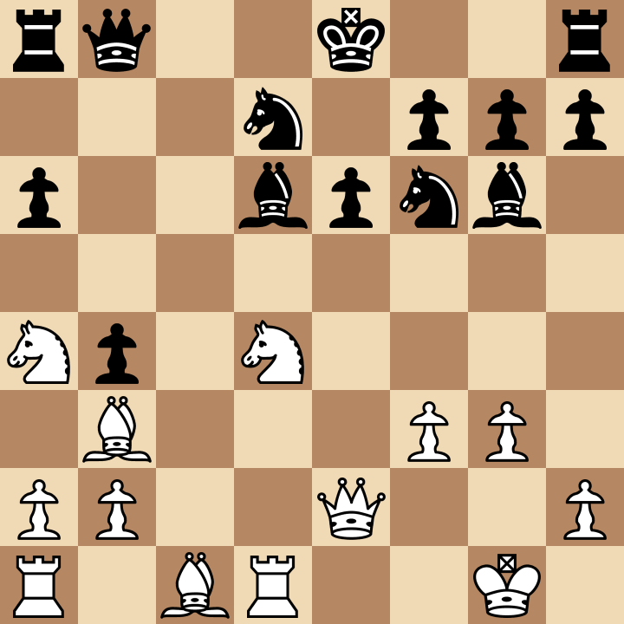
Chess 4.0 lost to CHAOS, a Type B machine. The most famous move of the tournament came in this position, with CHAOS playing white against Chess 4.0. White to move. A small triumph for Type B.
Slate, Swartz and Berman, CHOAS against Chess 4.0, 1974 WCCC.

Slide 20
1977 MacHack crushed by Robert Fischer.
1978, David Levy easily defeats Chess 4.7 using an anti-computer strategy of waiting until the machine weakens its own position.
Started in 1973 at Berkeley by Elwyn Berklekamp and Ken Thompson (then a struggling student), a machine developed by Thompson at Bell Laboratories, BELLE, won the AMC tournament and the WCCC in 1980. It used a whole new approach. It was a Type A machine, but with specifically designed ”chess processors.” This hardcoding was immensely more difficult and time-consuming. But moving instructions from rules (programs) to structure (chip architecture) was the only way to get massive increases in speed.
1981 saw the creation of the MIT Edward Fredkin prize: $5,000 for USCF master title, $10,000 for IM and $100,000 for beating the WC.
1982 Thompson ran an experiment that seemed to show that a single ply of depth increased playing strength by 250 points. This meant a factor of about 2 in computing power equaled about 100 points by speed alone. This was hugely influential.

Slide 21
Still, computers were terrible at the endgame, just as they had been at the opening before the creation of opening books. A discussion between Levy and Thompson further back had led the latter to spend ten years developing the idea of retrograde analysis. In 1977 he was able to show that strong grandmasters (such as Walter Browne) often could not win with Queen versus Rook against his machine within the 50 move rule. Since then seven move table bases, as they are called, have been developed. The 7 piece table base is 140 terabytes, and an 8 piece table base would take 1 petabyte of storage space.
A game between Belle an Carl Storey (2206) illustrates this well. Even 11 plies is far too weak to play the endgame against a knowledgeable player.
1984 David Levy played Cray Blitz to satisfy another bet. Levy easily won using anti-computer methods.

Slide 22
The Cray 1 supercomputer cost $10.5 million in 1984 ($25 million today). 50 miles of wiring. Cray 2, produced in 1985 performed 1.9 gigaflops. (The ratio of the cost of a gigaflop between 1984 and today is about $45 million/$0.03)
New ideas of the 1980s: Null move searching, singular extensions.

